Slide 1
App / Data Developer Workshop
Welcome

Slide 2
Denver Startup Week – Jeff Renz
Introduction to Video Game Development
Tuesday 9/25
12:00pm — 1:30pm
Are you a creative person that thinks that you have an amazing idea for a video game but has no experience or knowledge on how to actually make a video game? This session will expose you to the Unity3D engine and C# which allows you to generate video games in different rendering formats (windows, mac, android, iPhone, Xbox, PlayStation)..etc. At the end of this session you will have a basic understanding of game development techniques and will be ready to start creating your own basic video games.

Slide 3
Agenda
Git Presentation and Lab
What is Git
Installation and the basics on the command-line
Microsoft Visual Studio integration
Branching and common branch strategies
Advanced examples like merging, cherry picking, rebasing and history revision
Using GitHub and “Pull Requests”
Apache NiFi Presentation
What is Apache NiFi
Uses and Architecture Examples
Core Concepts of NiFi
NiFi Architecture
High Level Overview of Key NiFi Features

Slide 4

Introduction to
Not just for coders

Slide 5
What Is Git
A “stupid content tracker”
A random three-letter combination that is pronounceable and not actually used by any common UNIX command.
Global Information Tracker
Go#$%^ (gosh darn) idiotic truckload of sh#% (poop)
Torvalds quipped about the name git (which means unpleasant person in British English slang): "I'm an egotistical bastard, and I name all my projects after myself. First 'Linux', now 'git'." The man page describes Git as "the stupid content tracker".

Slide 6
Git for source control
Version Control – Visual Source Safe
Concurrent Version Control – TFS, Subversion
Distributed, Concurrent Version Control – GIT!

Slide 7
Let’s install Git

Slide 8
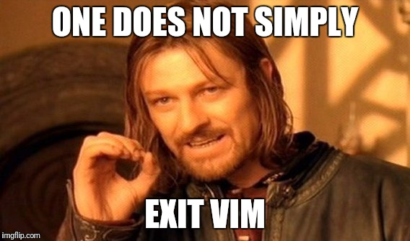
What default editor will you choose? VIM is the default but beware:

